Slide 1

Voice/Text Input
NLU Processing
ERP Gateway
Response Output
AI Voice-Controlled ERP Assistant
Natural Language Interface for ERP Operations — a system that enables users to interact with enterprise resource planning functions using voice or text commands, eliminating the need to manually navigate complex ERP screens and forms.
Notes:
1

Slide 2

Problem Statement & Objective
The Problem
Our Objective
Enterprise ERP systems are powerful — but notoriously difficult to use. Accessing even routine data requires navigating multiple screens, filling forms, and understanding complex menu hierarchies.
Enable users to interact with ERP functions using natural language — voice or text — instead of manually navigating the system.
The Solution Architecture
  Traditional ERP navigation is slow, multi-step, and error-prone
  Repetitive operations consume disproportionate time for routine tasks
  Non-technical users face steep learning curves with complex interfaces
Voice / Text Input
User speaks or types a command in plain language
NLP Processing
Intent and entity extraction identify what the user wants
ERP Operation
Conversational interface with clarification and confirmation executes the task
Notes:
2

Slide 3


What Our System Does
Core ERP Capabilities
Interaction Features
Inventory Management
Attendance Operations
Dual Input
Intent + Entity
Query stock levels by item code or name — e.g., "Show stock for item P-102"
Mark and retrieve attendance with write confirmation — e.g., "Mark my attendance"
Voice and text input supported interchangeably
Understands what to do and which records to act on
Sales Reports
Employee Operations
Auto-Clarification
Write Guard
Retrieve aggregated sales data and summaries — e.g., "Get total sales from last month"
Access employee-related information and records on demand
Prompts user when required information is missing
Confirmation required before any write operation executes
Real examples: "Show stock for item P-102" · "Mark my attendance" · "Get total sales from last month"
Notes:
3

Slide 4
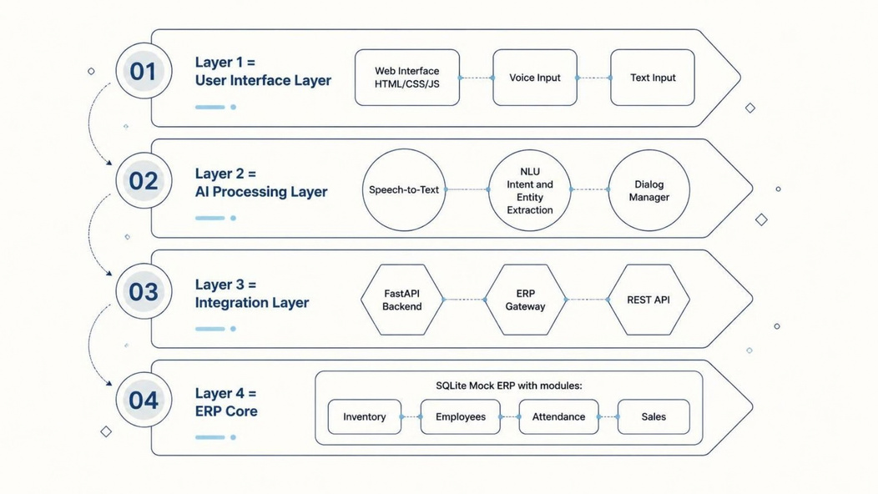
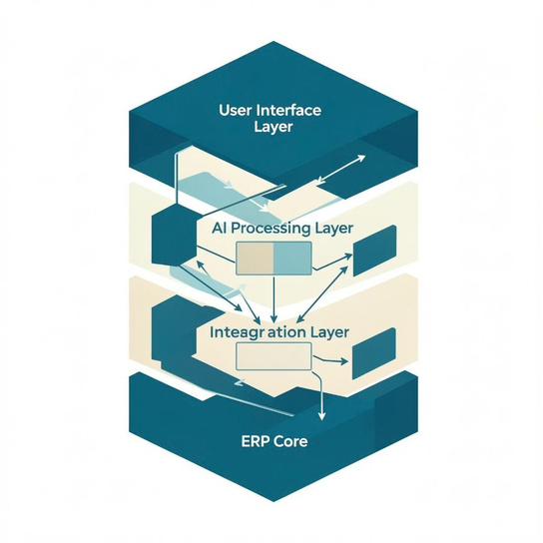
System Architecture
The system is organized into four distinct layers, each with a clear responsibility — from capturing user input to executing ERP operations on the database.
UI Layer
AI Processing Layer
Integration Layer
ERP Core
Web-based interface accepting both voice and text input. Provides real-time feedback and displays assistant responses.
Core intelligence: transcribes speech, extracts intent and entities, and manages multi-turn conversation state.
FastAPI backend routes validated requests through the ERP Gateway to the appropriate ERP function via REST.
SQLite mock ERP stores Inventory, Employees, Attendance, and Sales data — mirroring a real ERP schema.
Notes:
4

Slide 5

End-to-End Request Flow
Example walkthrough: "Show stock for item P-102" — tracing a command from spoken input to delivered response.
① Voice / Text Input
1
User speaks or types the command into the web interface
2
② Speech-to-Text
Audio converted to text via Whisper or Vosk — text input bypasses this step and enters NLU directly
③ NLU Processing
3
Intent = Stock Query | Entity = P-102 — extracted via rule-based or LLM-based NLU
4
④ Dialog Manager
Validates completeness and intent reliability; requests clarification or confirmation if needed
⑤ ERP Gateway
5
Routes validated request to the appropriate ERP function via FastAPI
6
⑥ Database Query
SQLite retrieves stock information for item P-102
⑦ Response
7
Result formatted as text and optionally converted to speech via pyttsx3
Text input bypasses Speech-to-Text and enters the processing pipeline directly at the NLU stage — enabling fast, low-latency interactions without audio hardware.
Notes:
5

Slide 6



NLU, Entity Resolution & Dialog Management
1. Natural Language Understanding (NLU)
3. Dialog Manager — Conversation Intelligence
1
The Dialog Manager is the safety and intelligence layer that ensures operations are complete, confirmed, and correct before execution.
Intent Recognition
Missing Information Flow
Determines what the user wants — e.g., Stock Query, Attendance Mark, Sales Report
User: "Check stock"
Assistant: "Which item would you like to check?"
2
Entity Extraction
User: "P-101" → Result returned
Identifies relevant objects — item codes, employee IDs, date ranges
Write Confirmation Flow
3
User: "Mark my attendance"
Assistant: "Confirm marking attendance for today?"
Dual NLU Modes
Rule-based (default): fast, deterministic, pattern-limited via regex
LLM-based (optional): Ollama + Llama 3.2, more flexible, handles natural variation
User: "Yes" → Operation executed
2. Entity Resolution
Ensures data integrity and user intent clarity before any database write.
Users don't need to know exact ERP record IDs. Fuzzy matching connects spoken or name-based references to ERP records — "hydraulic valve" resolves to P-102. Uncertain matches trigger a clarification prompt rather than silent, potentially incorrect guessing.
Notes:
6

Slide 7




Technology Stack
Frontend
Backend & Processing
  HTML, CSS, JavaScript
  Web-based UI with dual voice and text input
  Real-time response display
  Python, FastAPI, Uvicorn, Pydantic
  Rule-based NLU via regex/pattern matching
  Optional: Ollama + Llama 3.2 for LLM-based NLU
Speech Processing
Data & Communication
  Speech-to-Text: Whisper (API/local) or Vosk
  Text-to-Speech: pyttsx3
  Pluggable architecture — swap STT/TTS engines independently
  Database: SQLite (mock ERP schema)
  API: HTTP/REST communication
  Modules: Inventory, Employees, Attendance, Sales
Notes:
7

Slide 8
Key Demonstrated Use Cases
The following use cases are fully implemented and demonstrable end-to-end in the current system.
📦 Inventory Query
🗓 Attendance Management
"Show stock for item P-102"
"Mark my attendance"
System resolves item code, queries SQLite inventory table, and returns current stock level in a formatted response.
Dialog Manager triggers confirmation prompt. On user approval, attendance record is written to the database — no accidental writes.
📊 Sales Report
🔄 Clarification Flow
"Get total sales from last month"
"Check stock" → "Which item?" → "P-101"
Date entity extracted, ERP Gateway queries the sales table, aggregated total returned and spoken aloud via TTS.
Incomplete commands trigger a targeted follow-up. System awaits the missing entity before routing to ERP — demonstrating multi-turn dialog.
Interactive Mode: Users can enter custom commands and observe the system's intent extraction, entity resolution, dialog state, and ERP response in real-time during the demonstration.
Notes:
8

Slide 9


Current Implementation & Future Scope
Currently Implemented ✓
Limitations & Future Enhancements →
End-to-End Text Pipeline
NLU Flexibility
Real ERP Integration
Working input-to-response pipeline via web interface and FastAPI backend
Rule-based NLU has limited language variation coverage — enhance with optional Ollama LLM integration already scaffolded
Replace mock SQLite with production ERP — Odoo, SAP, or PostgreSQL-backed systems
Mock SQLite ERP
Inventory, Attendance, Sales, and Employees modules with realistic schema
Rule-Based NLU
Production Security
Multilingual Support
Intent recognition and entity extraction via regex/pattern matching
Implement OAuth2/JWT authentication (currently placeholder) + rate limiting and security hardening
Extend NLU and STT to support regional and international languages
Dialog Manager
Clarification loops and write confirmation before all database mutations
Proactive Alerts
Cloud Deployment
Fuzzy Entity Resolution
ERP-driven notifications — low stock alerts, attendance anomalies, sales thresholds
Docker containerization and cloud deployment for scalable, production-ready operation
Name-based references matched to ERP records without exact ID input
Pluggable Speech I/O
Whisper/Vosk for STT · pyttsx3 for TTS — swappable without core changes
Notes:
9

Slide 10





Conclusion
The AI Voice-Controlled ERP Assistant demonstrates a working natural-language interface for ERP operations — connecting voice and text input through NLU, dialog management, and API integration to deliver ERP data and actions without manual navigation.
User Input
NLU
Dialog Manager
Voice or text command
Intent + entity extraction
Clarify + confirm
ERP Gateway
Response
Route + execute
Text + speech output
Simplifies ERP Interaction
Flexible Input Methods
Foundation for Integration
Natural language replaces complex multi-screen navigation — any user can access ERP functions without training
Voice and text workflows supported interchangeably — the same pipeline handles both modalities seamlessly
Architecture is designed for real ERP systems — swap SQLite for Odoo or PostgreSQL and deploy to production
Thank You
We welcome your questions and feedback.
Notes:
10

